Slide 1
August 30 , 2016
Good morning/afternoon ☺
Please get out your notes and something to write with. Duplicate the Circular Flow Matrix that appears on the board in your notes. (If you have different colored pens that may be helpful today).

Slide 2
Let’s Review
What are the four Factors of Production?
What are consumer goods (consumption)?
What are government goods?
What are exports?
Today, we are going to understand how the Factors of Production play a role in our households, business and government.

Slide 3
Circular Flow Model

Slide 4
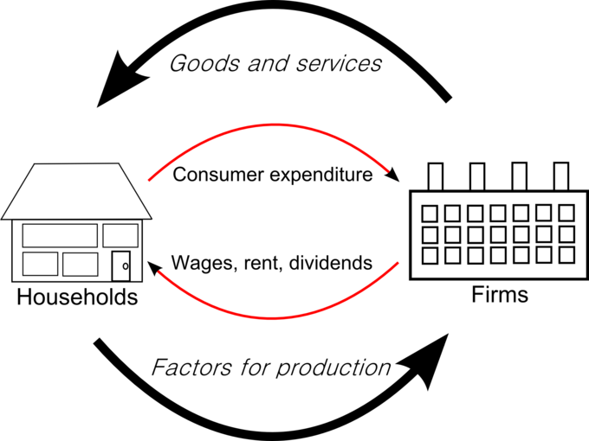
THE CIRCULAR FLOWS
  Circular flow model (matrix) shows:
  The circular flow of expenditures and incomes that result from decision makers’ choices and
  The way those choices interact in markets determines what, how, and for whom goods and services are produced.

Slide 5


Households and Businesses
Households and Businesses
  Households are individuals or people living together as decision-making units.
  Firms (businesses) are institutions that organize production of goods and services.

Slide 6


Markets
Markets
  A market is any arrangement that brings buyers and sellers together and enables them to do business.
  Product (goods) markets: markets in which goods and services are bought and sold.
  Resource (factor) markets: markets in which factors of production are bought and sold.

Slide 7
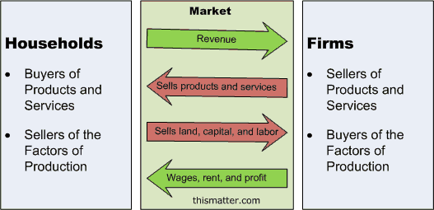
Real Flows and Money Flows
  In factor markets:
Households supply factors of production
Firms hire factors of production.
  In goods markets:
Firms supply goods and services produced.
Households buy goods and services.

Slide 8
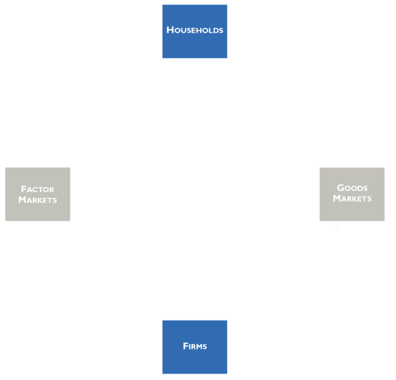
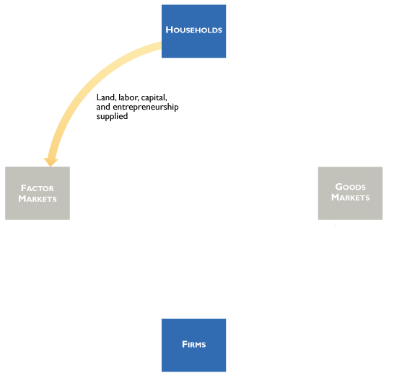
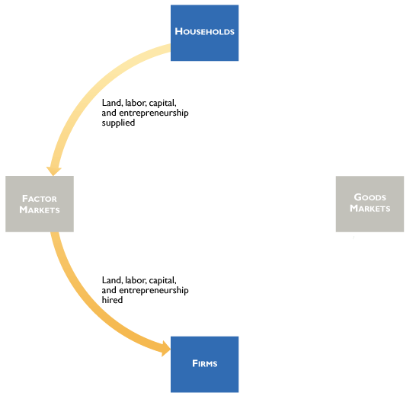
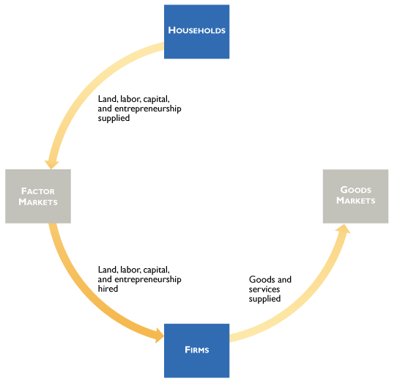
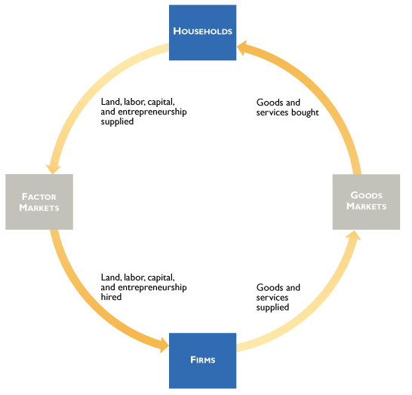
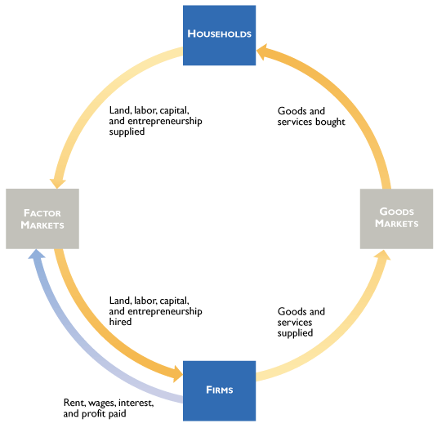
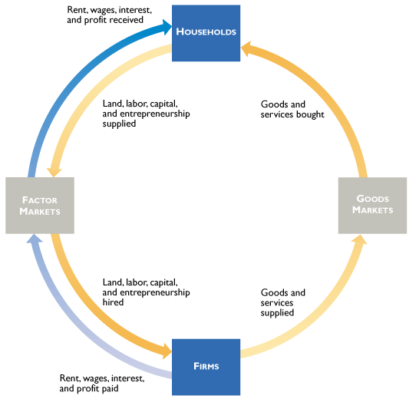
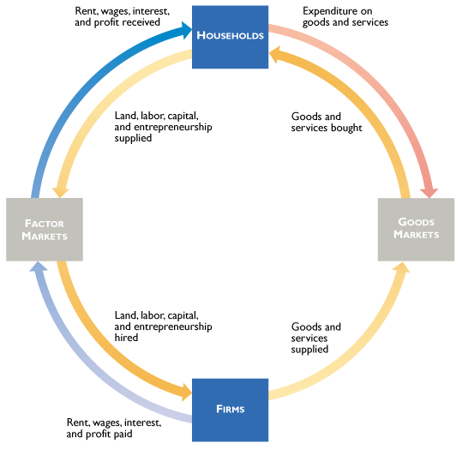
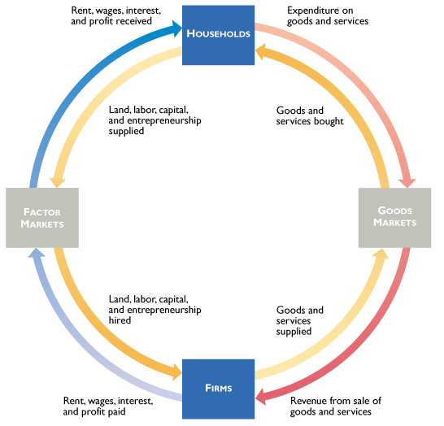
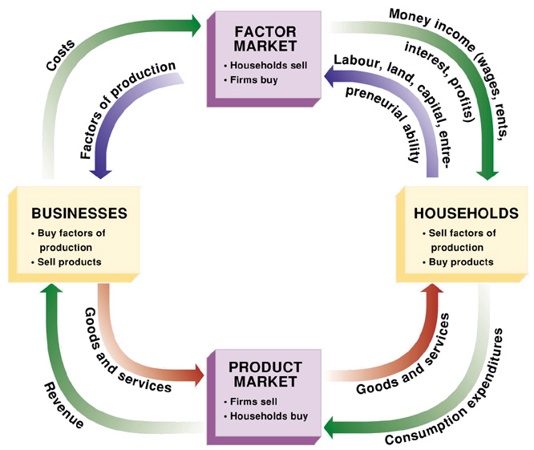
Real Flows and Money Flows, cont’d.
MONEY FLOWS
    Firms pay for the factors of production and households incomes for the services of factors of production.
    Households pay firms for the goods and services they buy which creates revenue for the businesses..
    These are the money flows.
    Green flows are incomes.
    Red flows are expenditures.

Slide 9


Government in the Flow
  The federal government’s major expenditures are to provide
    1. Goods and services
    2. Social Security and welfare benefits
    3. Transfers to state and local governments
  The federal government finances its expenditures by collecting taxes.
  The main taxes are
    1. Personal income taxes
    2. Corporate (business) taxes
    3. Social Security taxes
  In 2008, the federal government spent $3 trillion—about 21 percent of the total value of all the goods and services produced in the United States in that year (GDP or Gross Domestic Product).
  Taxes raised less than $3 trillion—the government had a deficit.

Slide 10
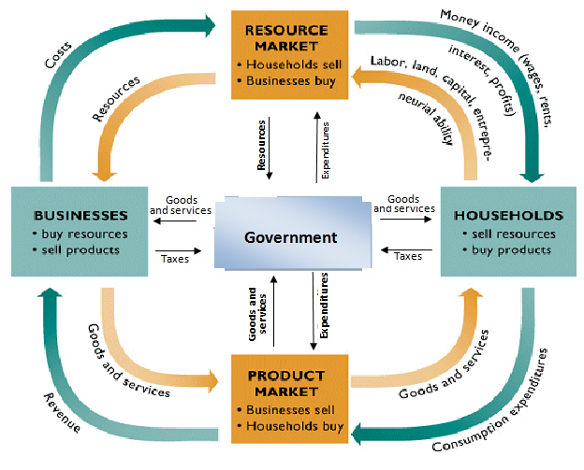
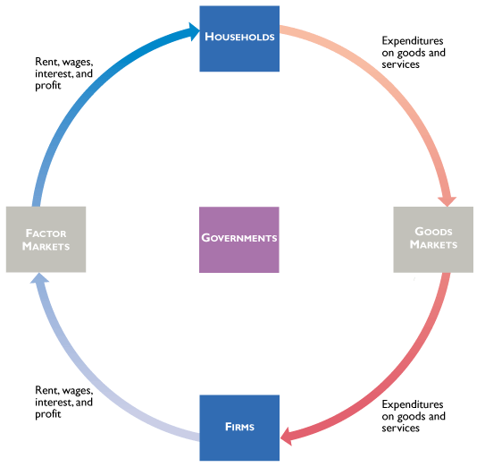
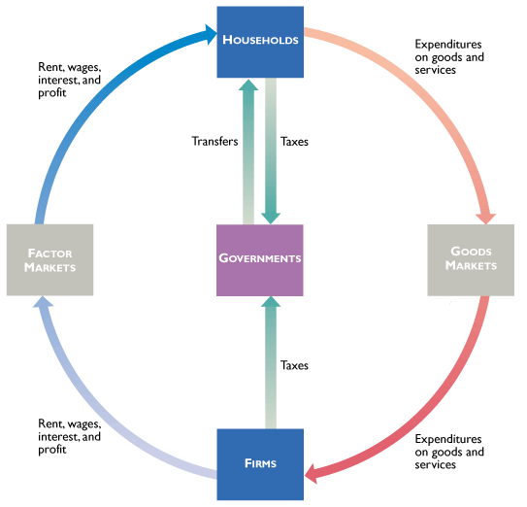
Governments in the Circular Flow
● Households and firms pay taxes and receive transfers.
●Governments both provide and buy goods and services.

Slide 11

Mr. Clifford

Slide 12

Circular Flows in Global Economy
Households and firms in the U.S. economy interact with households and firms in other economies in two main ways:
They buy and sell goods and services. They borrow and lend.
We call these two activities:
  International trade – buying (imports), selling (exports)
  International finance – borrowing and lending

Slide 13
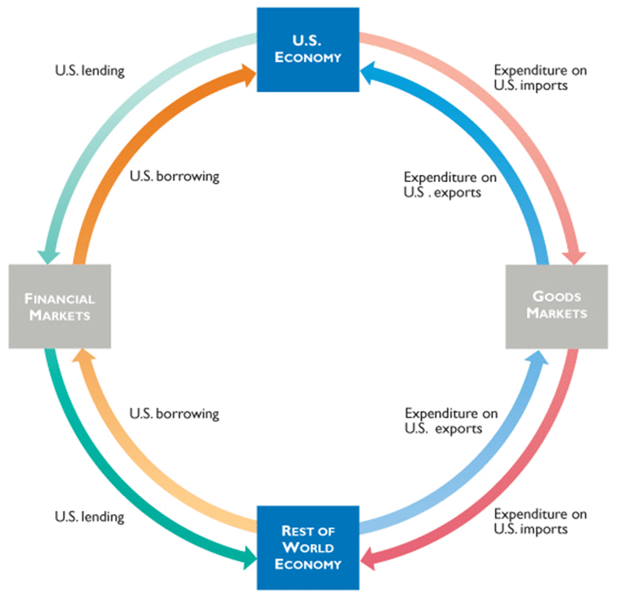
Global Flow
  Households and firms in the U.S. economy interact with those in the rest of the world in goods markets and financial markets.
The red flow shows the expenditure by Americans on imports of goods and services
The blue flow show the expenditure by the rest of the world on U.S. exports (other countries’ imports
  The green flow shows U.S. lending to the rest of the world.
  The orange flow shows U.S. borrowing from the rest of the world.

